Slide 1
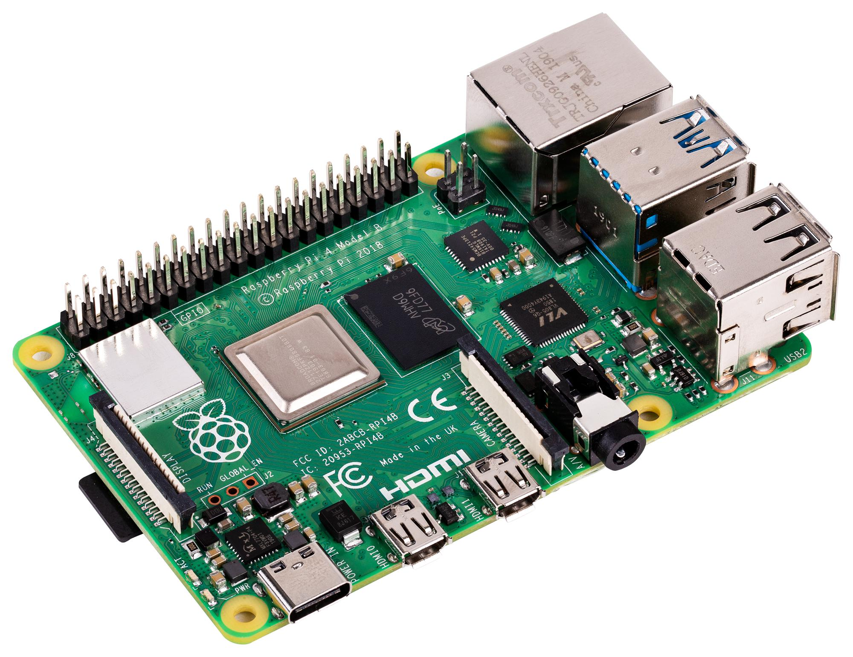
Build Your Own IoT!
Fun With a Raspberry Pi
By A.J. Fisher For the Perth Data Engineering Meetup
21/02/2024

Slide 2

Agenda
Presentation Purpose
Quick Definitions
Project Inspiration
Hardware
Software / Pipeline
Next Steps to IoT
The Real World
Conclusion
Questions

Slide 3
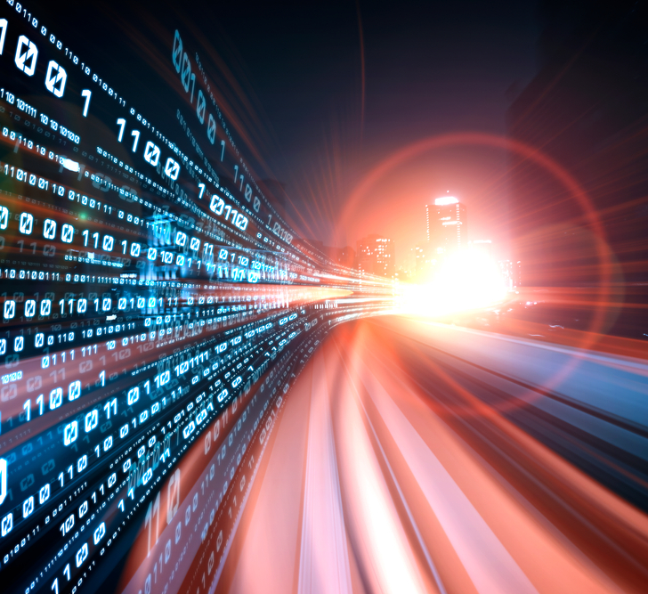
Project goals
Assemble a basic EL(T) streaming data pipeline that can be used for IoT applications
Encourage newcomers – anyone can build a streaming data pipeline!
Get closer to the bare metal
Share something I had a lot of fun doing

Slide 4
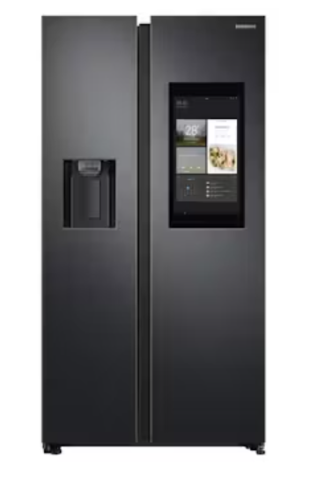
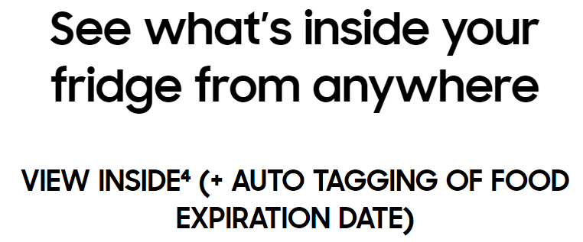

Quick Definitions
IoT – Internet of Things
Physical “Things” meet digital
May involve device control
Estimated 29 BILLION devices by 2030!
Streaming Data Pipeline
Get data every 1 second
Send / receive in the cloud continuously
Source 1
Source 2
Source

Slide 5

WHY? Introduction to pi

Slide 6


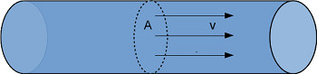
1
2
3
4
Engineers typically interact with batch data
Temperature sensor
TAG: PIPE1XXTEMP01
25°C
Timestamp | PIPE1XXTEMP01
14-Feb-24 14:05:48 | 21
14-Feb-24 14:15:48 | 22
14-Feb-24 14:25:48 | 23
14-Feb-24 14:35:48 | 25
14-Feb-24 14:45:48 | 24
14-Feb-24 14:55:48 | 23
14-Feb-24 15:05:48 | 22

Slide 7
PI Demo – dashboard and excel

Slide 8

Most Importantly…
Pie Data
Timestamp | RASPB-PIE-003
14-Feb-24 14:01:50 | DELICIOUS
14-Feb-24 14:11:50 | DELICIOUS
14-Feb-24 14:21:50 | Just ok I guess
14-Feb-24 14:31:50 | DELCIOUS
14-Feb-24 14:41:50 | DELICIOUS

Slide 9
hardware

Slide 10
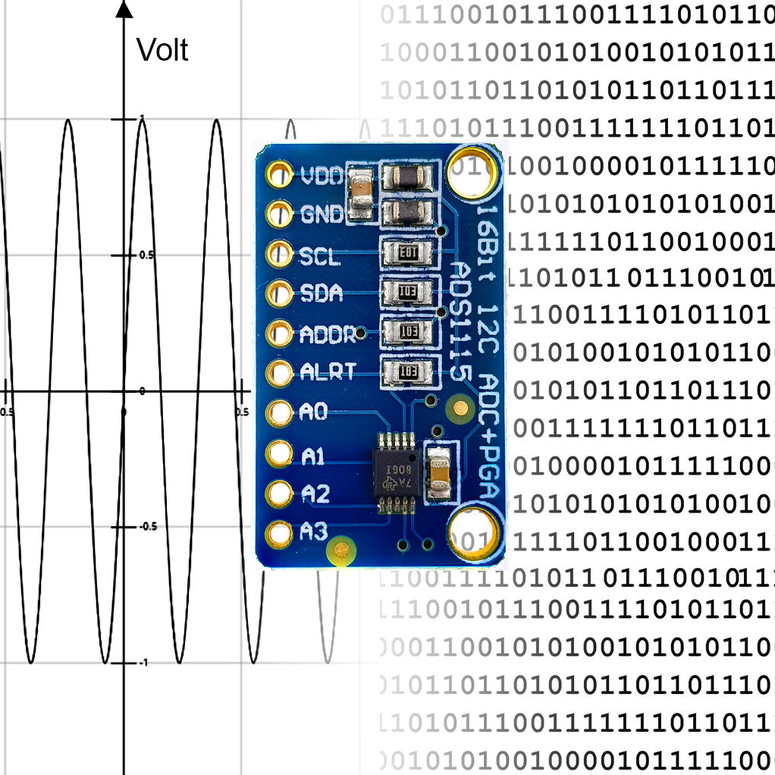
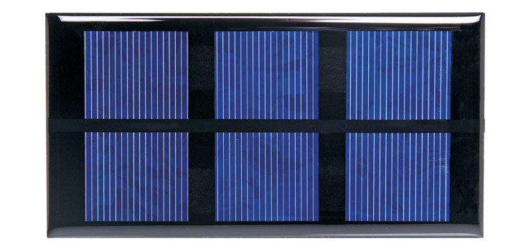
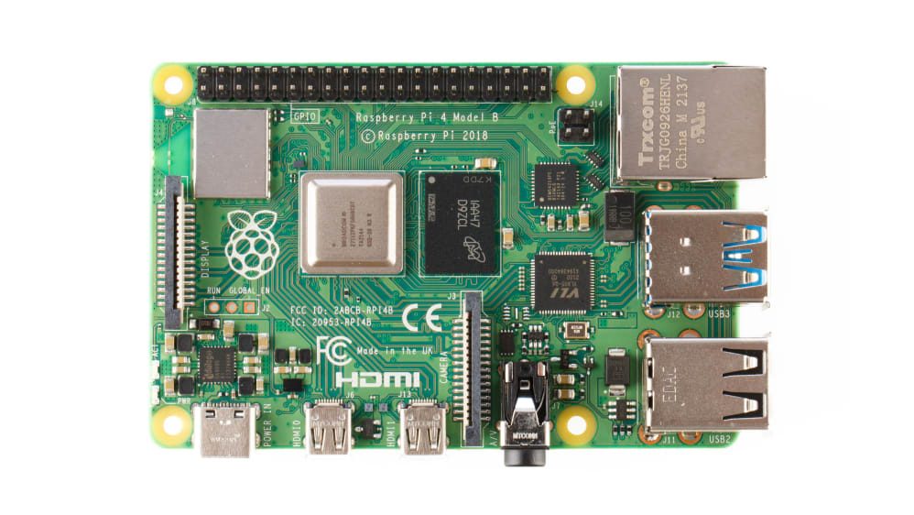
Meet the team
SENSOR: solar panel
Translator: Analog-to-Digital-converter (ADC)
SERVER: Raspberry pi

Slide 11
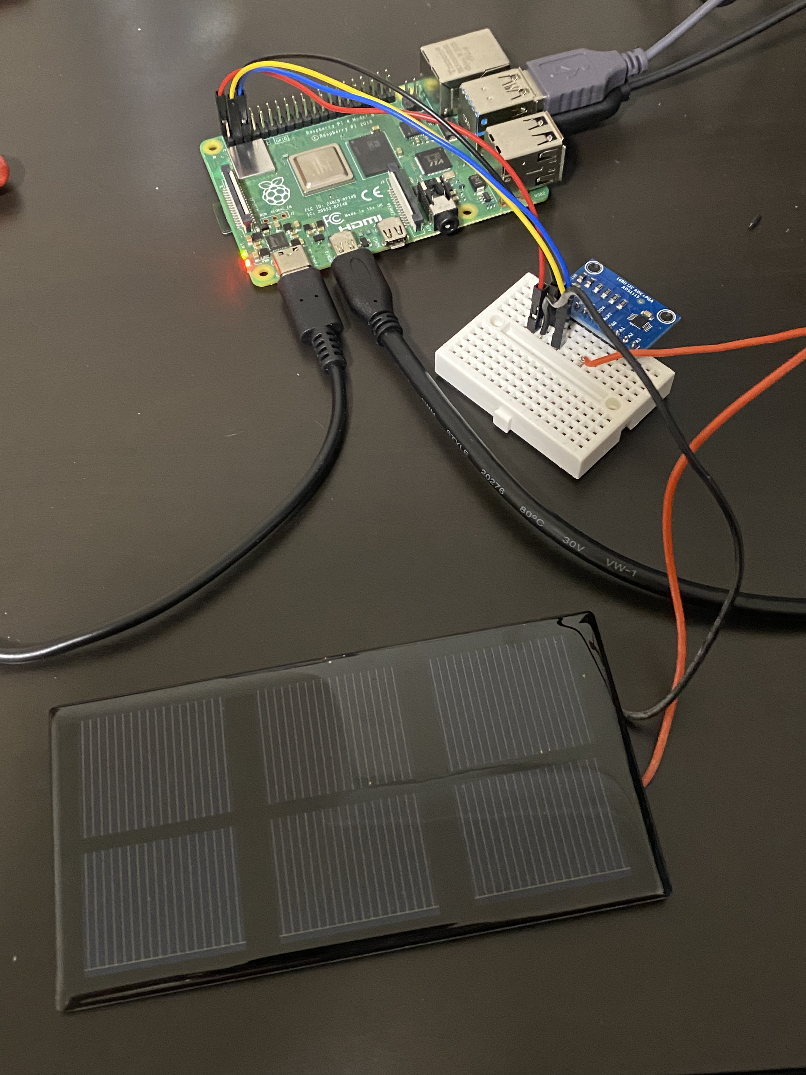
Full setup

Slide 12
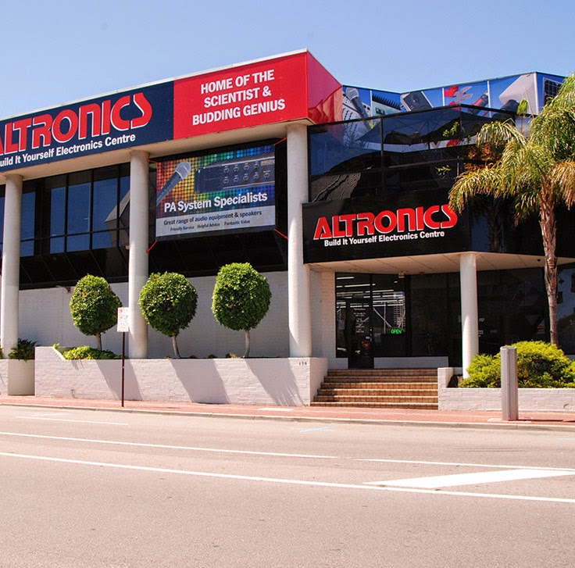


Notes on hardware
Where can I get ALL THIS hardware?
“But I’ve never done electronics before!”
All project hardware can be acquired from Altronics in Northbridge!
174 Roe Street, Northbridge WA 6000
Altronics N0720 0.75W Mini Solar Panel
Adafruit ADS1115 16 Bit ADC
Raspberry Pi 4 Model B 4GB
You can do it!
A.J. started with nothing too
Having a friend with an electrical engineering background is nice but…
LOTS of YouTube videos in the electronics community
Soldering can be tricky

Slide 13
Software and data pipeline

Slide 14
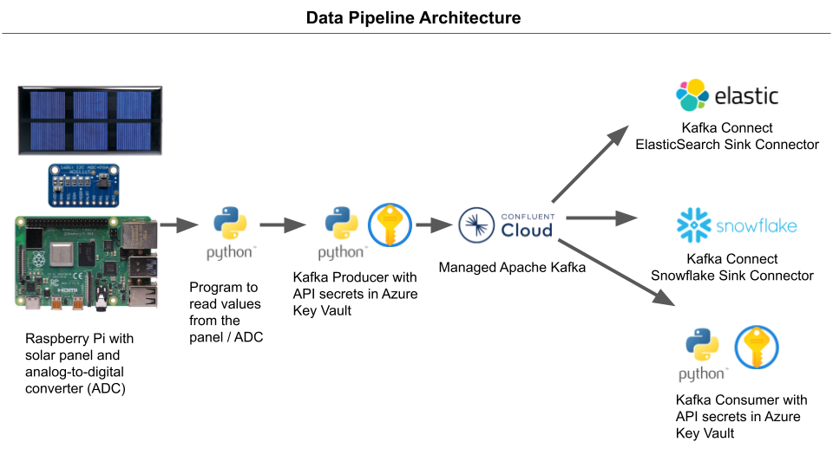

Slide 15
Ext
Extract
Read a voltage value from the solar panel

Slide 16
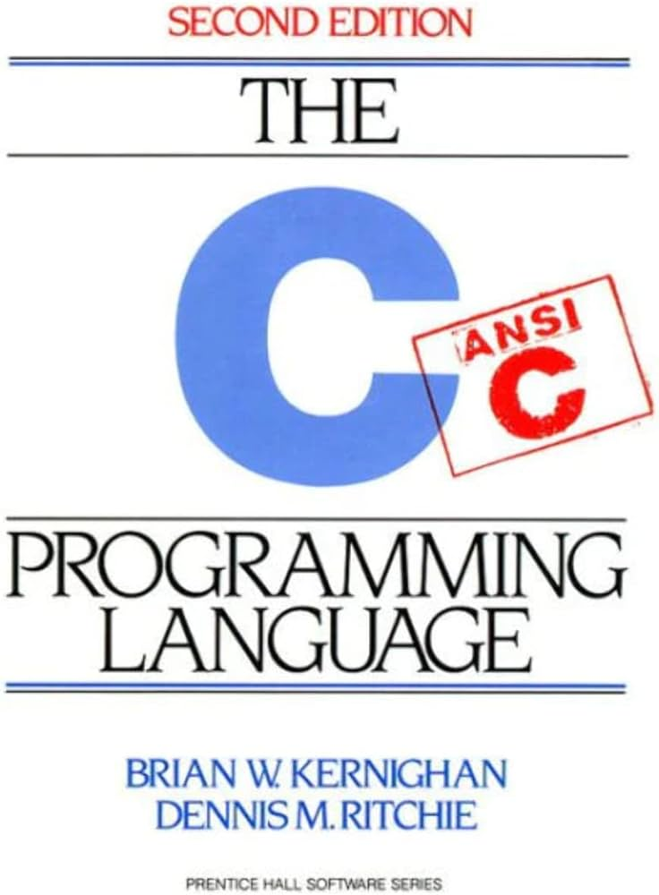
Extract
Read a voltage value from the solar panel
?

Slide 17
Extract
Library

Slide 18
Sending the message
Measure and send voltage each 1 second
Serialised JSON message:
{
"connection_ok": True,
"panel_producing": "SOLAR_PANEL_1",
"voltage_volts": voltage,
}
Schema registry enabled
Not measured. Dummy values.
Mimics “real” reading
Actually measured each second

Slide 19
Extract
Kafka producer: send voltage reading to Kafka in the cloud

Slide 20

Extract
Kafka producer: send voltage reading to Kafka in the cloud
?

Slide 21
Extract
Course

Slide 22
Extract
Kafka in the cloud. Which cloud?

Slide 23
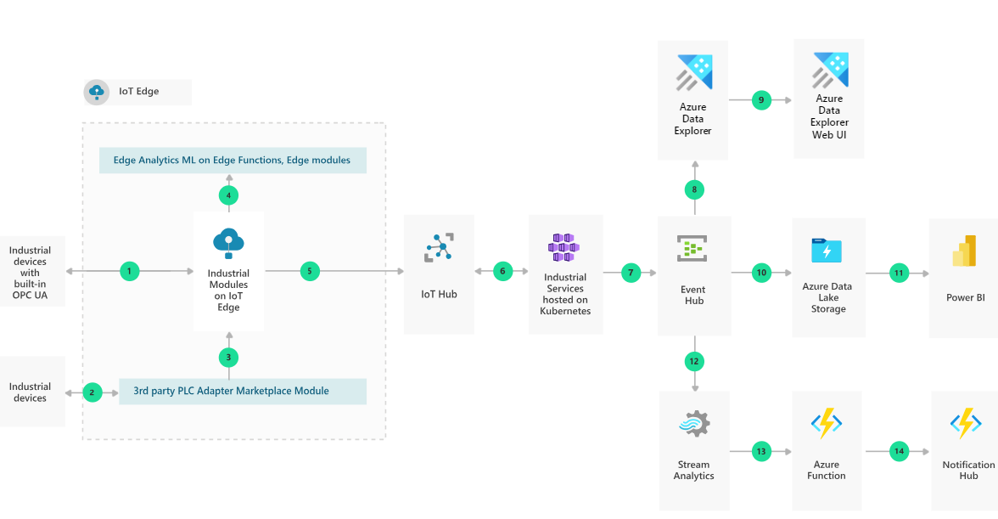

Choosing a Cloud: Focusing on Data, Not Infrastructure
Cloud– can be a lot for beginners
Want something beginner friendly
Managed Kafka - data, not infrastructure
Expensive… BUT great for hobby, rapid prototyping & sizing
VS

Slide 24
Extract
Load
Store data for analysis
Store data for analysis

Slide 25
Extract
Load

Slide 26
Extract
Load
Kafka consumer for
app / analysis

Slide 27
Extract
Load

Slide 28
Extract
Load

Slide 29

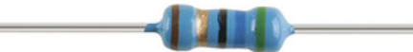
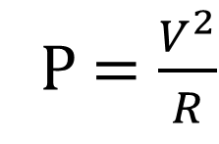
Extract
Load
Transform
Convert volts to watts
P$=\frac{V^{2}}{R}$

Slide 30
Extract
Load
Transform
Convert volts to watts
P$=\frac{V^{2}}{R}$
Transform?

Slide 31

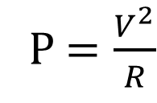
Extract
Load
Transform
Convert volts to watts
P$=\frac{V^{2}}{R}$
Transform?
Transform?

Slide 32
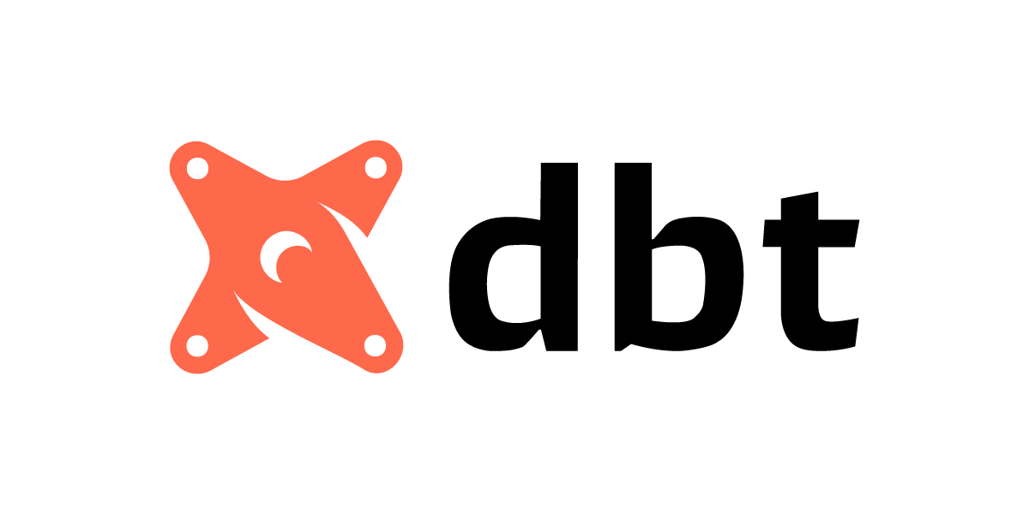
Extract
Load
Transform
Convert volts to watts
P$=\frac{V^{2}}{R}$
Transform?
Transform?
Transform?

Slide 33
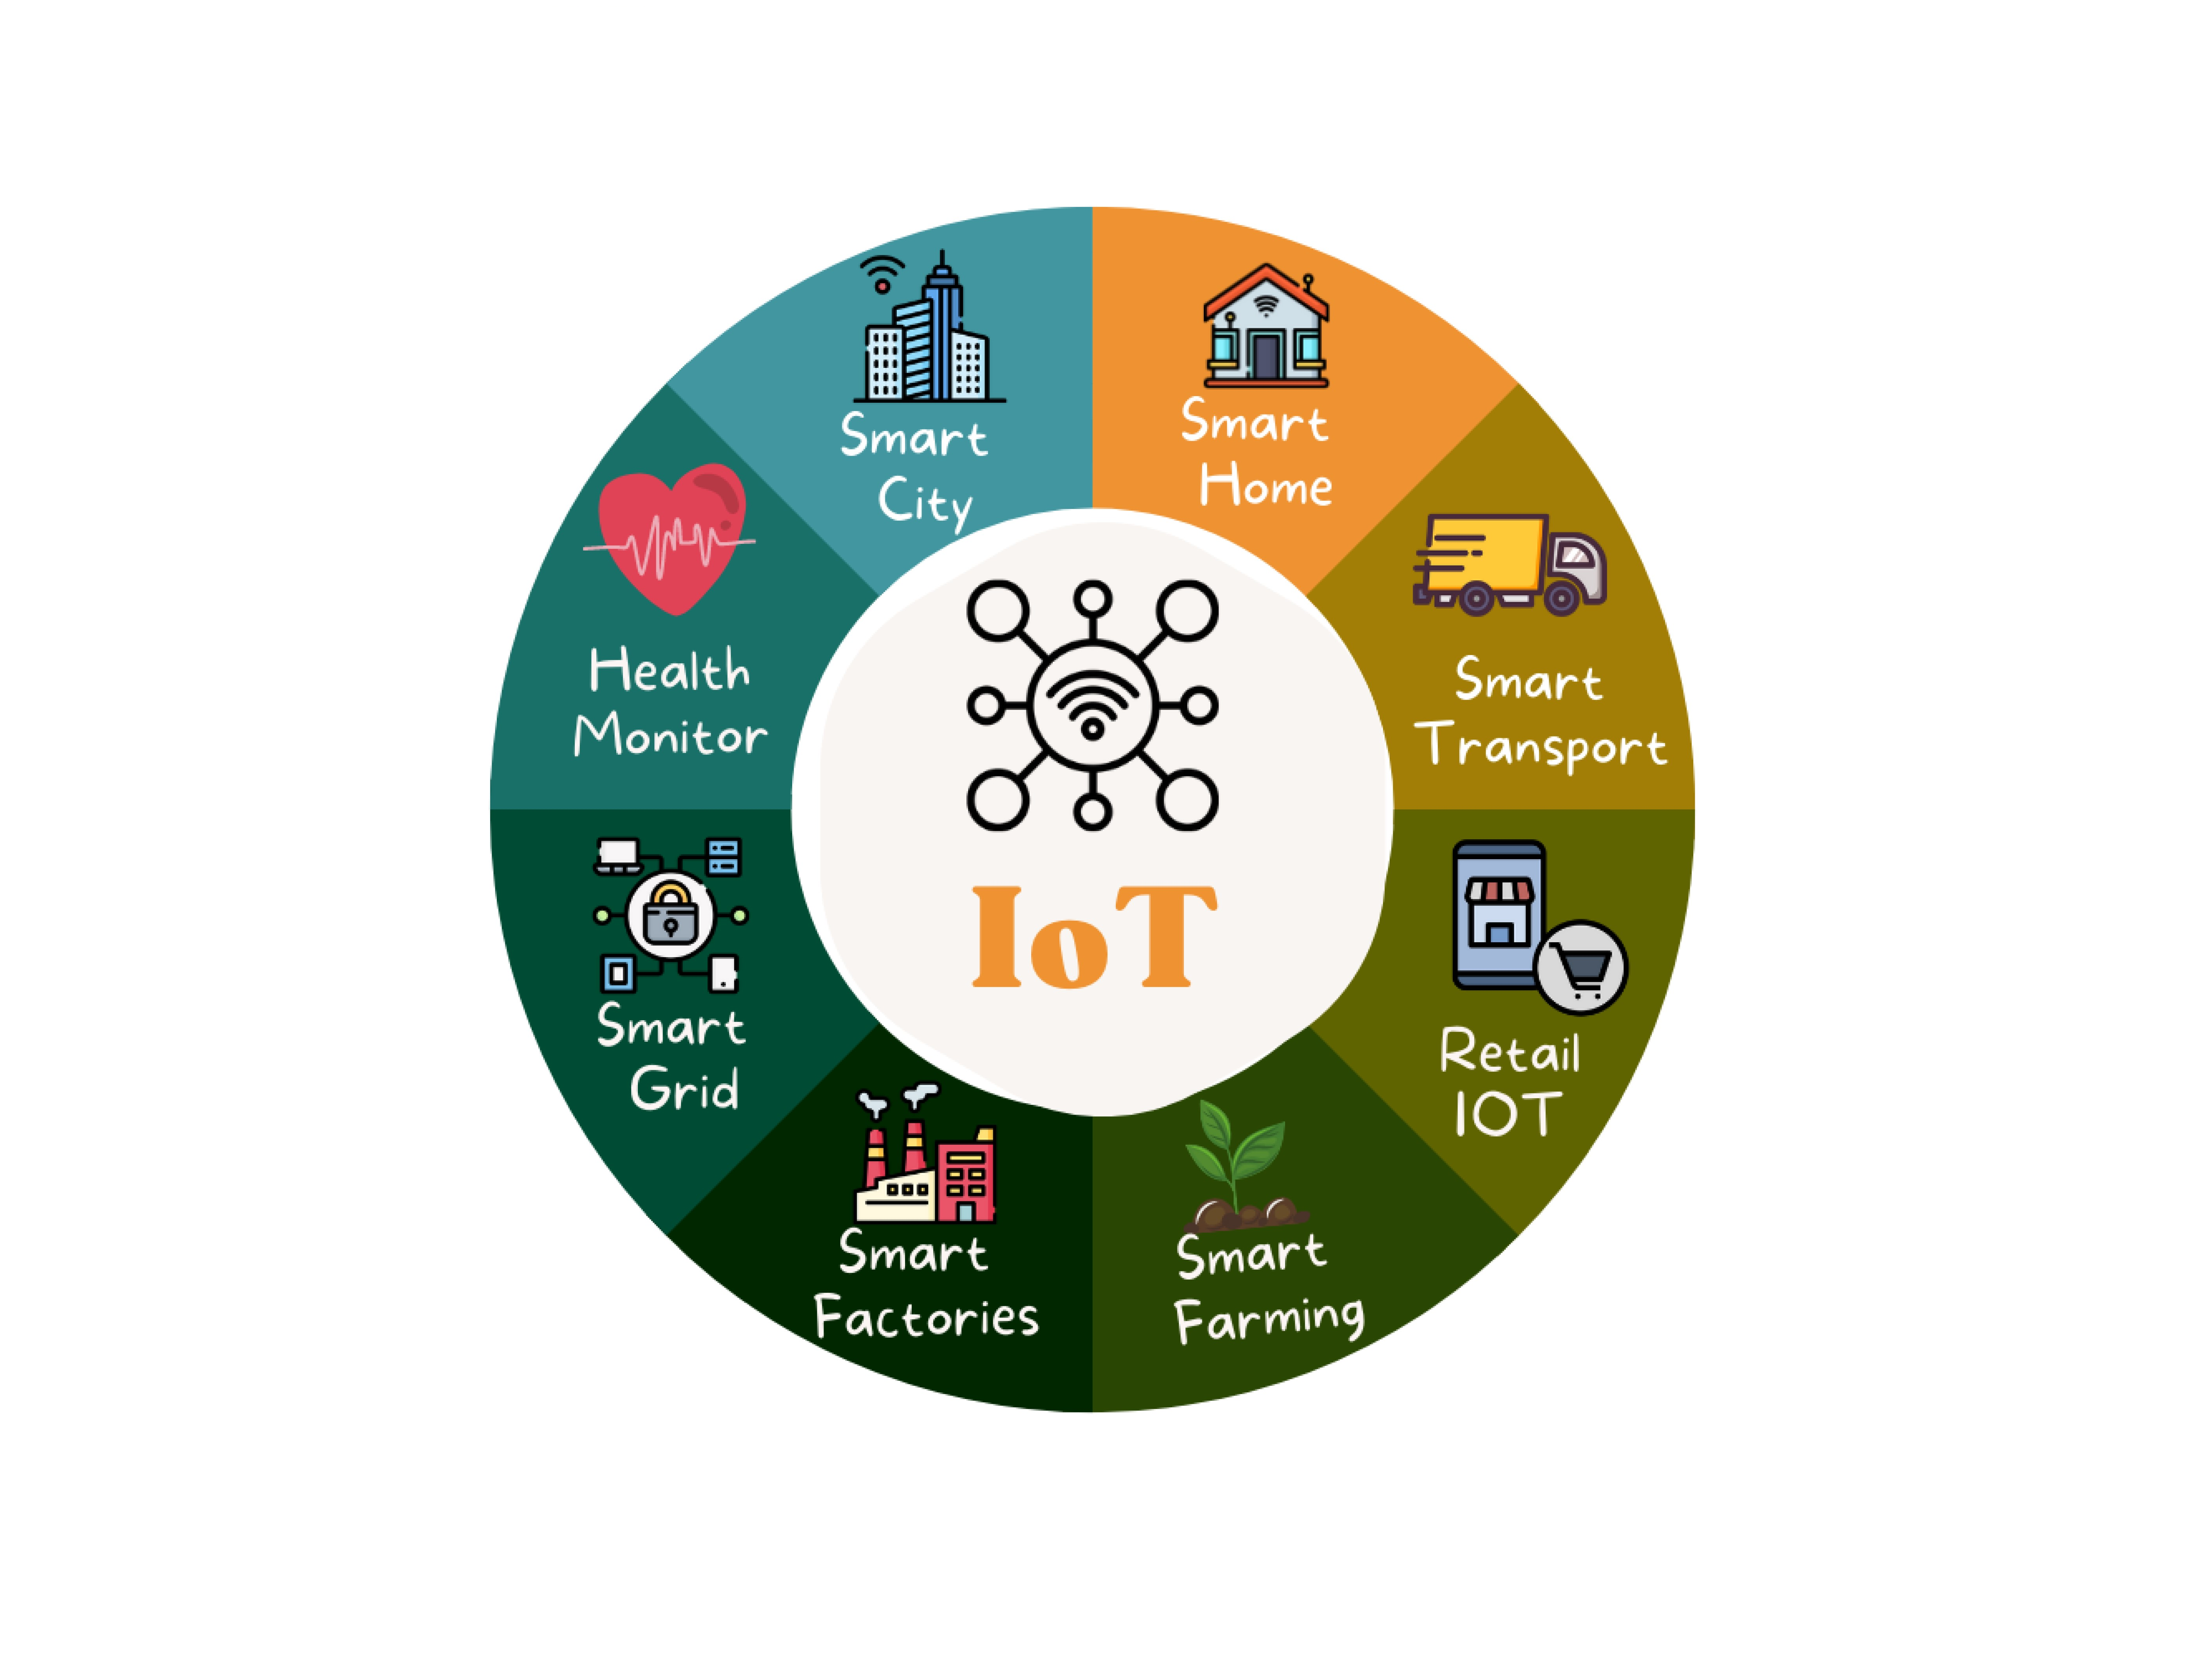
NEXT STEPS TO IoT

Slide 34

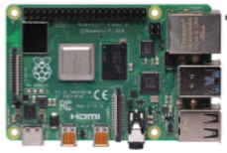


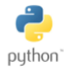
PART ONE: THE Journey so far
Data archive
Local server
Downstream consumer
(On central server)

Slide 35
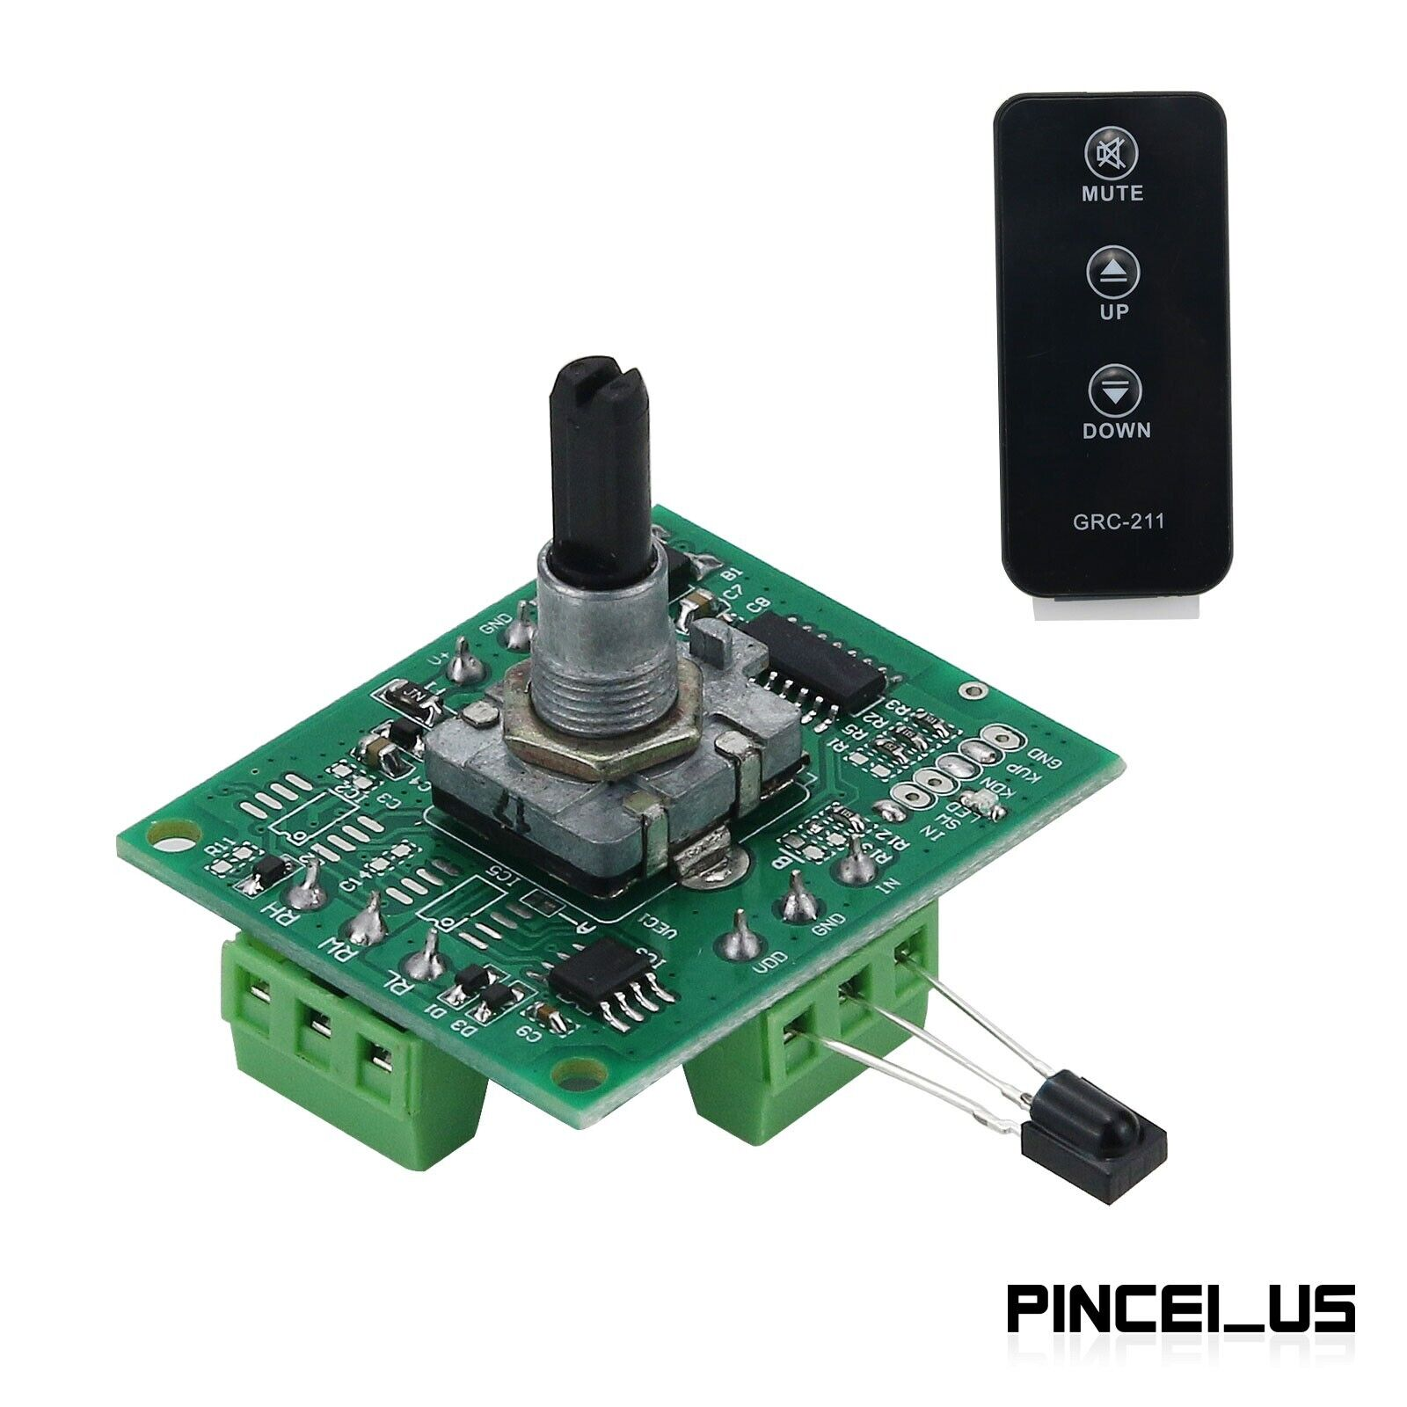
Step TWO: REVERSE PIPELINE WITH ACTUATION
Digital actuator
(variable resistance
potentiometer)
Local server
Central server

Slide 36



Step Three: Build the presentation layer
Digital actuator
(variable resistance
potentiometer)
Local server
Central server

Slide 37

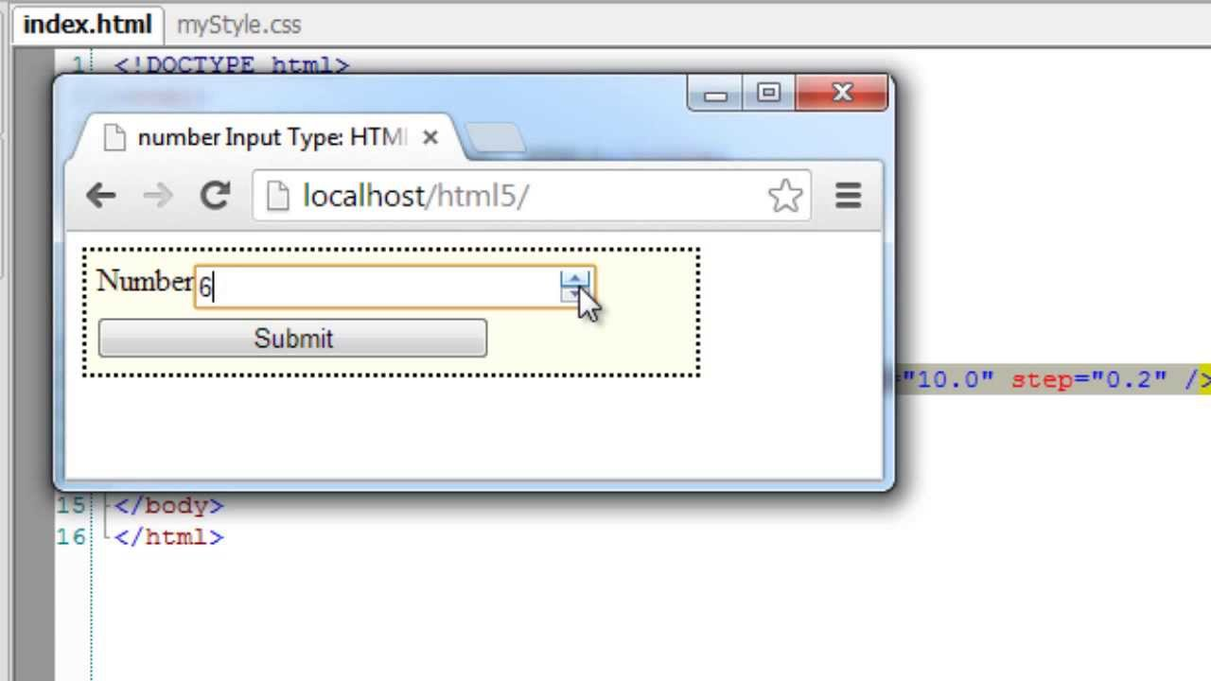
Step four: Build a simple application interface
Use Django to set
the potentiometer
resistance
Digital actuator
(variable resistance
potentiometer)
Local server
Central server

Slide 38

The real world

Slide 39
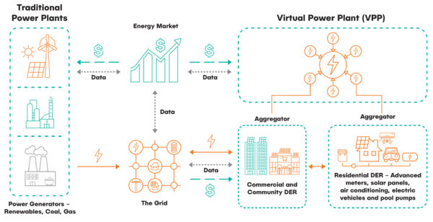
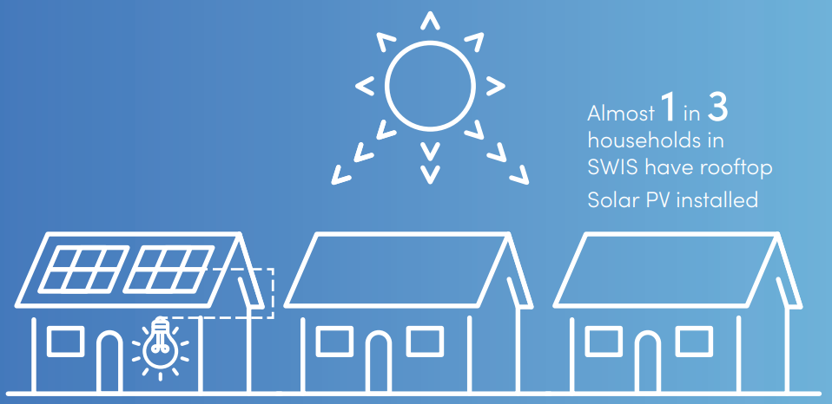
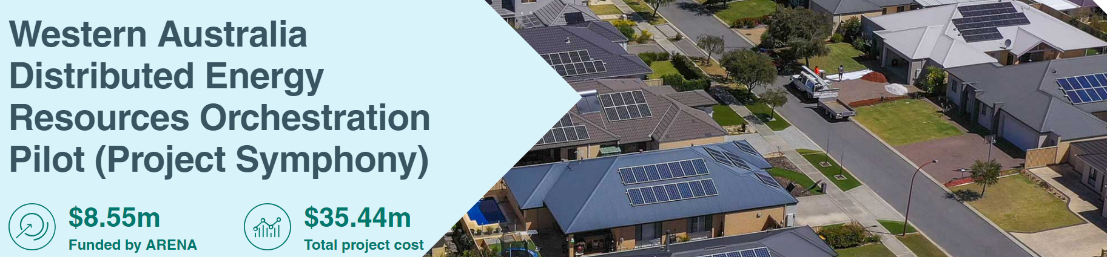
The real world: project symphony
Project Symphony
Source

Slide 40

Conclusion
We learned a bit about PI
Built a basic streaming data pipeline that can be used for IoT applications
Anyone can build a streaming data pipeline
Building data pipelines is fun

Slide 41
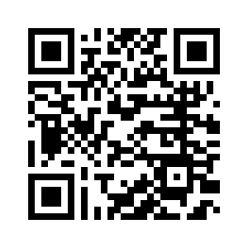
Thank you!
AJTheDataGuy@gmail.com
https://www.linkedin.com/in/ajfisher2/

Slide 42

APPENDIX A: Tests

Slide 43
tests
"""{"$id": "https://github.com/AJTheDataGuy/myURI.schema.json",
"$schema": "https://json-schema.org/draft/2020-12/schema#",
"additionalProperties": false,
"description": "JSON Schema definition for solar panel voltage data",
"properties": {
"connection_ok": {
"description": "Adding a boolean just for fun. Represents whether the panel is connected properly or not.",
"type": "boolean"
},
"panel_producing": {
"description": "Defines which solar panel is sending the message (only 1 in this hobby project)",
"type": "string"
},
"voltage_volts": {
"description": "Voltage from the panel in volts",
"type": "number"
}
},
"title": "SolarPanelVoltageSchema",
"type": "object"
}"""
Mix of unit and integration tests
Unit test example
Is this schema string valid JSON?
Integration tests
Get ADC channel, get voltage value
Lingering Challenges:
Hardware – loose connections
Pytest not failing on server timeout

